Slide 1
Legal Disclaimer
© IBM Corporation 2018. All Rights Reserved.
The information contained in this publication is provided for informational purposes only. While efforts were made to verify the completeness and accuracy of the information contained in this publication, it is provided AS IS without warranty of any kind, express or implied. In addition, this information is based on IBM’s current product plans and strategy, which are subject to change by IBM without notice. IBM shall not be responsible for any damages arising out of the use of, or otherwise related to, this publication or any other materials. Nothing contained in this publication is intended to, nor shall have the effect of, creating any warranties or representations from IBM or its suppliers or licensors, or altering the terms and conditions of the applicable license agreement governing the use of IBM software.
References in this presentation to IBM products, programs, or services do not imply that they will be available in all countries in which IBM operates. Product release dates and/or capabilities referenced in this presentation may change at any time at IBM’s sole discretion based on market opportunities or other factors, and are not intended to be a commitment to future product or feature availability in any way. Nothing contained in these materials is intended to, nor shall have the effect of, stating or implying that any activities undertaken by you will result in any specific sales, revenue growth or other results.
Performance is based on measurements and projections using standard IBM benchmarks in a controlled environment. The actual throughput or performance that any user will experience will vary depending upon many factors, including considerations such as the amount of multiprogramming in the user's job stream, the I/O configuration, the storage configuration, and the workload processed. Therefore, no assurance can be given that an individual user will achieve results similar to those stated here.
All customer examples described are presented as illustrations of how those customers have used IBM products and the results they may have achieved. Actual environmental costs and performance characteristics may vary by customer.
All references to fictitious companies are used for illustration purposes only.

Slide 2
Name
Title

Slide 3
IBM Cloud, defined...
IBM Cloud is an enterprise grade, full stack platform, purpose built for data-intensive AI workloads and cloud-native application suites, delivered on software definable infrastructure.
Notes:
We are working with clients on the future of IBM Cloud. Today, that means …
Cloud-native shift: Gives you the things you can’t get on premises. But going to cloud is more than where does a server run. No private business can create infinite horizontal scale – no single business can replicate this. Data is constantly increasing, and we must gain ground in leveraging data – the only way to do this is to get your business onto a scalable platform that can leverage machine learning/deep learning, in a secure way.
Cloud-native attributes: Cloud native is about building resiliency in – expecting the infrastructure to fail – building scalability in – so that application can self-heal, self-scale, self-grow with self-service.
Software-defined cloud: Spun up in automated fashion – no human intervention required.

Slide 4

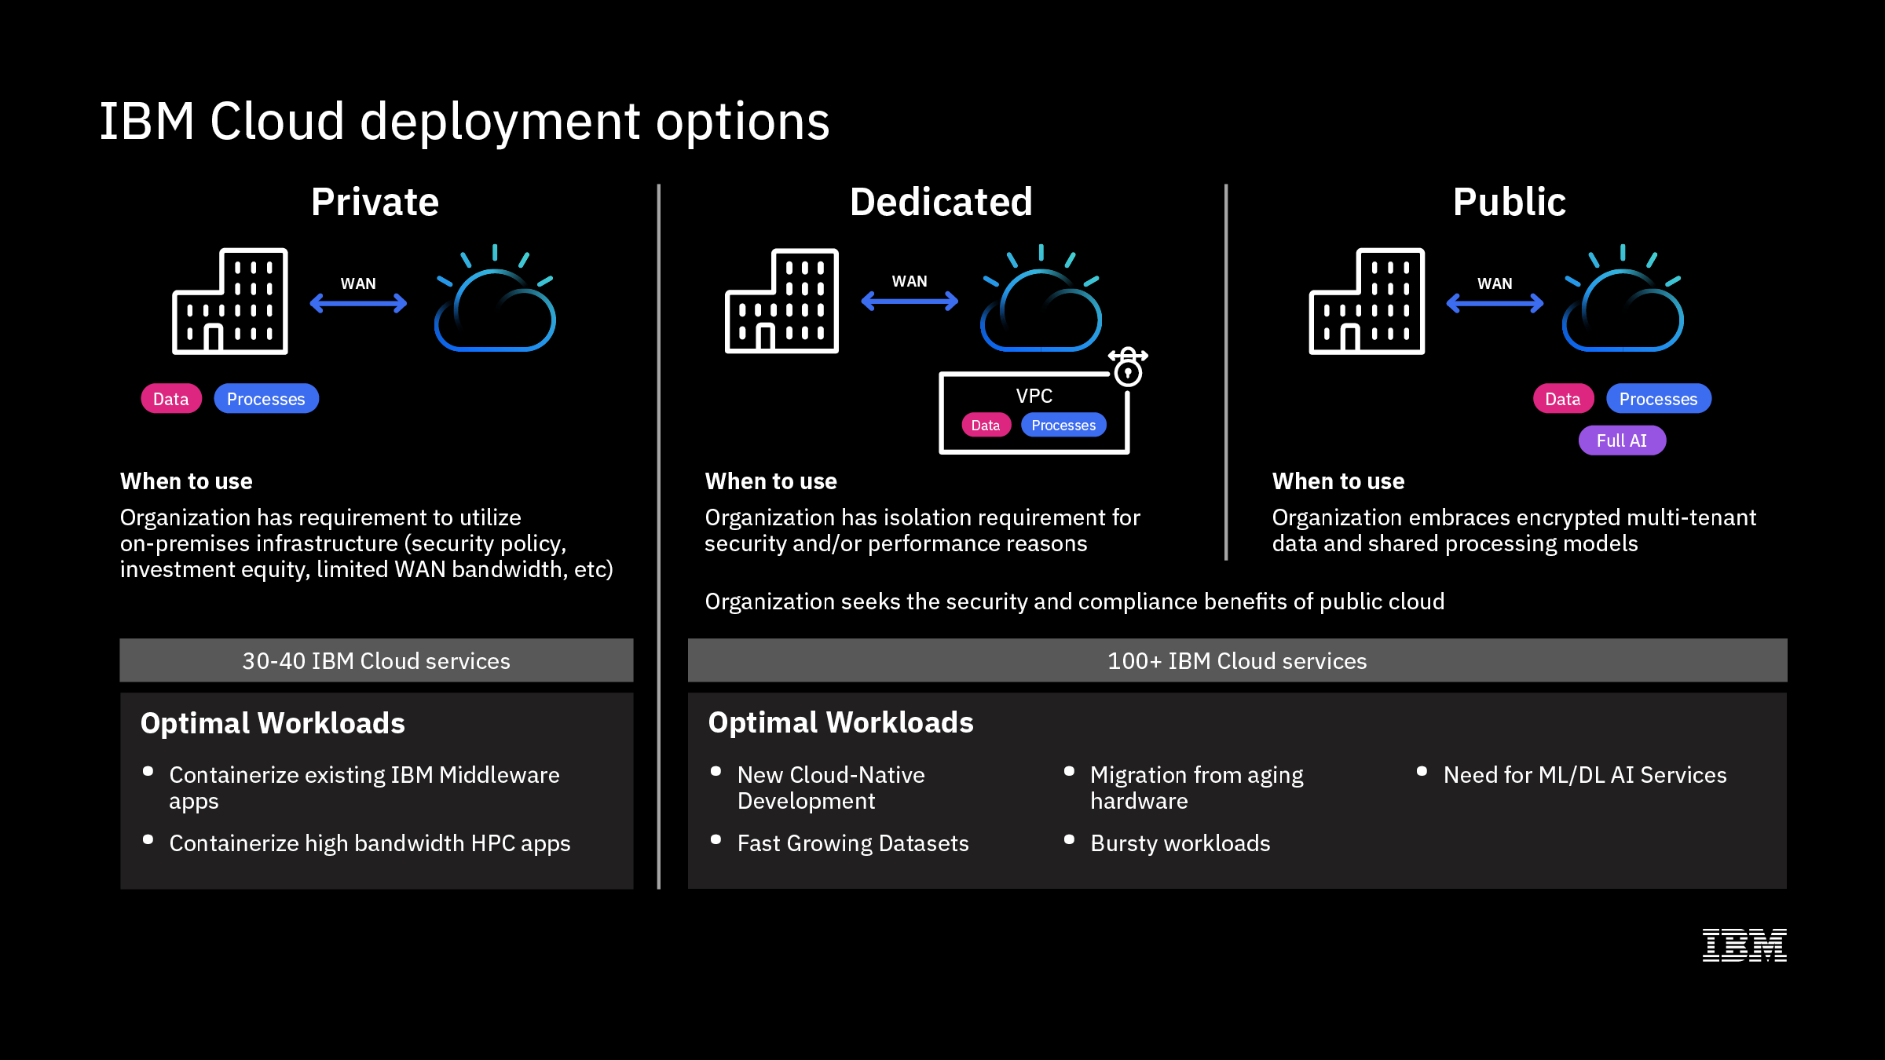
Deploy the right type of cloud to accelerate innovation
IBM Cloud / © 2018 IBM Corporation
4
Notes:
We recognize that not every organization is ready to move everything they have to a public cloud environment, and there are lots of reasons they are not able to do that. Perhaps it’s data security policies, whether their own or regulatory, perhaps they have a large investment in infrastructure or software licenses that they have not even come close to depreciating fully, or their WAN bandwidth is not high enough to support moving intensive workloads to the Cloud.
IBM Cloud has a range of deployment options – from Private to Public and Dedicated.
Private: Think of it as a containerized runtime environment you can deploy into on premises, and it is purpose built to do that for much of IBM’s middleware, data and analytics portfolio.
Dedicated is software definable isolation on the public cloud environment.
Public: Take advantage of the resiliency, elastic scalability, and other advantages of going cloud-native in a public cloud environment.

Slide 5
IBM Cloud architecture
IBM Cloud / © 2018 IBM Corporation
Notes:
First, let’s look at how IBM Cloud has evolved.
As you look at how the IBM Cloud architectural vision has become a reality (and everything on this chart is available), IBM Cloud has transformed into a full stack platform.
IBM Cloud is about solving your data problems and helping you capitalize on transformative business opportunities that can be found in data – your own data, publicly available data, licensed data – data that is flowing by at a rate and pace that no single entity, no matter how large, can keep up with.
Our specific specialty is part of a broader vision for addressing our clients’ biggest challenges and helping them capture their most compelling opportunities.

Slide 6
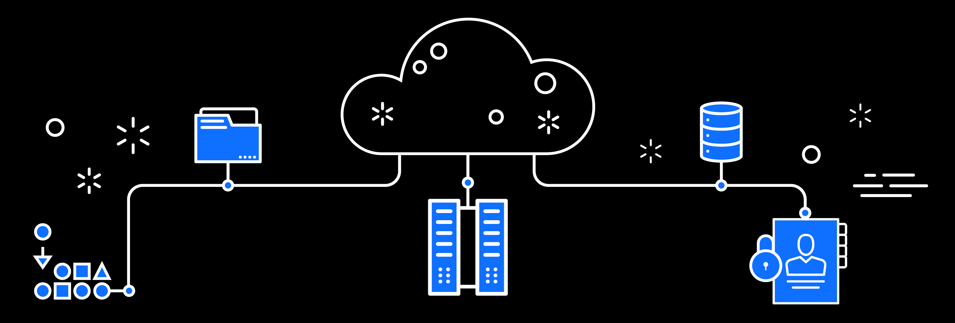

Innovate with the latest technologies from any cloud.
IBM is the Cloud for Business
AI
READY
BUILT FOR ALL YOUR APPLICATIONS
SECURE TO
THE CORE
Create innovative, cloud-native apps using AI, IoT, blockchain, high performance computing and other disruptive technologies
Exploit unmatched choice and industry expertise
Deploy it where you need to on a secure network, without sacrificing quality and compliance
IBM Cloud / © 2018 IBM Corporation
IBM Cloud / © 2018 IBM Corporation
Notes:
IBM Cloud is THE Cloud for Smarter Business. There are three core differentiators that guide our offerings:
AI ready: We are helping businesses become smarter by constantly learning new insights by using our AI Platform. We know that AI will become pervasive across most processes in a smarter business, and IBM Cloud has the tools to make this happen faster and across all data in all forms. For example, one client initially worked with IBM Cloud and Watson to provide AI call center tools, which eliminated 90% of the calls and reduced wait times from 10 minutes to 10 seconds. But now that they have started learning, they are expanding to multiple processes, and even built a new AI-only mobile banking application. A number of clients are just discovering the wealth of new data coming from IoT devices. A client committing to IBM Cloud will have a long-term partner as they deploy AI across their organization, using their own data.
Built for all of your applications: Some clouds were designed around a simple micro-services architecture in the mid-1990s. This worked for new applications, but has not worked for large enterprise applications, for regulatory compliance, nor for hybrid solutions across public and on-prem. All the clouds are talking "hybrid" now, but IBM has real leadership in leading clients on a cloud journey. IBM Cloud Private and the alignment around containers has made a huge difference to our ability to be the one cloud for all client applications. Our relationship with VMWare has also helped with migration, and we continue to introduce new offerings on IBM Cloud that deliver a high-speed connection between a client's data center and IBM Cloud for smooth migration and workload portability, among other things.
Secure to the core: IBM has always stood for security. At every level of our cloud, from the silicon to the infrastructure through the software and out to edge computing, we are obsessed with providing the highest levels of trust and security. And we make it even easier for clients to control their own environments. Public cloud will offer more consistent security features as the developers are deploying the code via containers, etc. For on-premises deployment, all security concerns will need to be addressed individually. IBM Cloud security is built-in, not bolted-on.

Slide 7
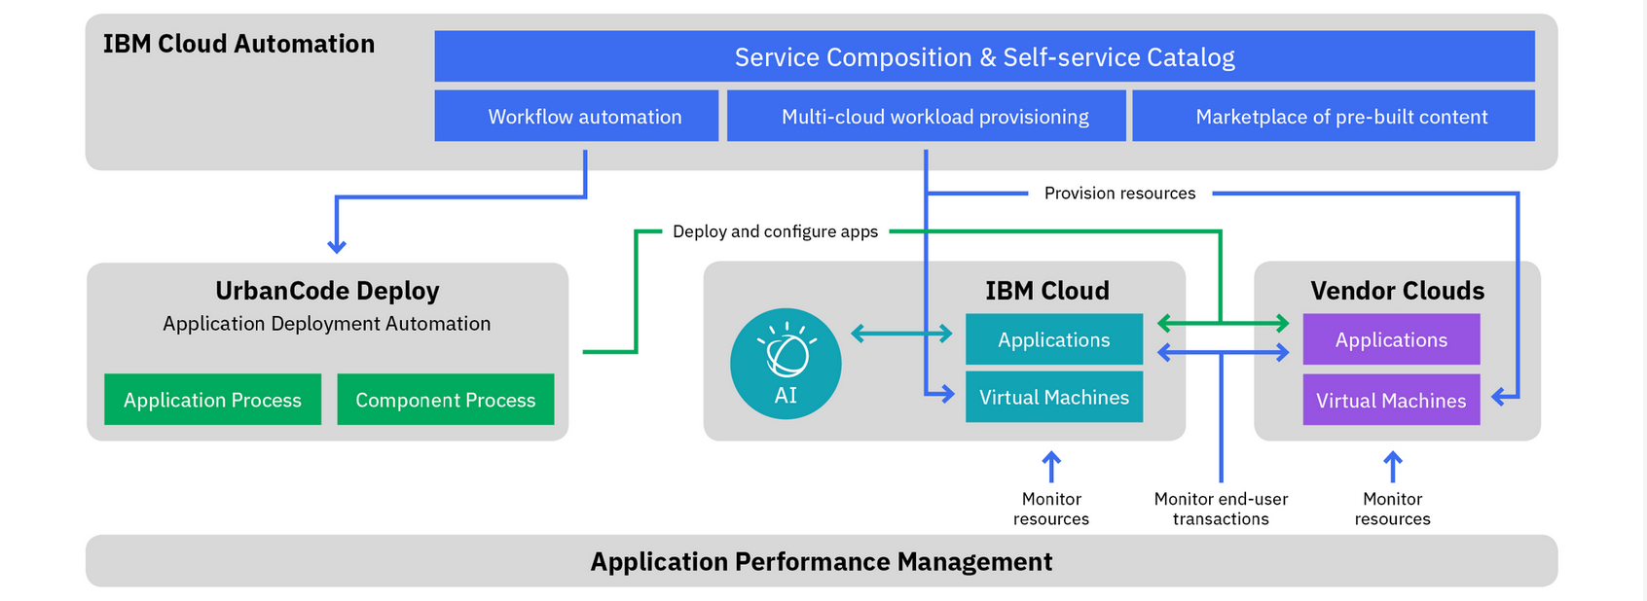
IBM provides tools to help clients manage multi-cloud environments
By 2020, more than 90% of enterprises will use multiple cloud services and platforms¹
¹IDC Futurescape, Worldwide Cloud 2018 Predictions
IBM Cloud / © 2018 IBM Corporation
Notes:
IBM is also uniquely positioned to help clients manage their workloads in a multi-cloud world. Just because we are the IBM Cloud guys, doesn’t mean we are only the IBM Cloud guys. We have tooling in place to help you – put that entire DevOps pipeline in place, the flow of code, the flow of deployment, flow of operations, from beginning to end to work in a multi-cloud world. We can help you determine the right environment for the right workload at the right time, with tools like Cloud Automation Manager.

Slide 8
Only the IBM Cloud delivers the technologies that power innovation for the enterprise
Data
Tools to prepare data for cognitive
Ingestion
Storage
Analytics
Deployment
Governance
AI
Cognitive building blocks for developers
Conversation
Discovery
Compare & Comply
DLaaS
Tone Analyzer
Personal Insight
API
API
API
API
API
API
API
Visual Recognition
API
Speech
API
Document Conversion
API
Nat Language Understanding
API
Nat Language Classifier
API
Knowledge Query
Cloud infrastructure
A highly scalable, security enabled infrastructure
Cloud Integration
Cognitive Micro-services
DevOps Tooling
Networking
Security
Core Enterprise Infrastructure
Cognitive
Systems
Virtual Servers
Object Storage
File Storage
Applications, solutions & services
Targeted solutions for enterprise businesses
Watson
Oncology
Watson
Cyber Security
Weather
IBM Services & Ind. Solutions
Watson
Virtual Agent
Watson Explore & Discover
IBM Risk & Compliance
Asset Mgmt. (Maximo)
IBM Cloud / © 2018 IBM Corporation
8
Notes:
As I mentioned, we’ve built a platform with technologies to help businesses deal with data.
For example, Watson Data Platform is a whole platform for how we ingest data, how we store, how we provide analytics tools – a platform construct. WDP is really meant to turn data into a “solved” problem – just like Infrastructure as a service makes infrastructure a solved problem. I want to be able to ingest my data, make sure it is governed, it’s compliant, it’s encrypted, no one can access it that isn’t supposed to, I am going to pass regulatory sniff test, my data scientists and developers can all use it.
All of the challenges that go on in data can be solved in the cloud because you have infinite horizontal scale. You have the ability to throw resources at problems that you can’t do in a private environment, so moving your data to the cloud can change the paradigm for how the team works together.
The team can work together to build apps faster, and all of these things to go faster and faster and faster. Going forward, it’s more about how the data scientist and developer can work closer together to make decisions around applications based on data and insights that are constantly being learned.

Slide 9
Matching the right cloud to the right workload
Public Cloud
Backup & archive
Front office/desktop
ERP
Enterprise transformation
required for cloud adoption
Big data & analytics
Disaster recovery
DevOps | Governance | Integration
Security | Architecture | Culture
Private Cloud
Risk & compliance services
Mature workloads
Workloads needing
low latency to back ends
Web applications/ e-commerce
Digital experience solutions
Existing database
workloads
Customer service
Maintain & Evolve
Applications with sensitive data
Enterprise social solutions
Applications with complex processes and transactions
Regulation-intensive applications
Third-party applications
Highly customized applications
Mobile applications
Information-intensive applications
Non-core business processes
* IBM Institute for Business Value study, “Tailoring Hybrid Cloud” August 2016
Not yet virtualized applications
Batch processing
Development and test workloads
IBM Cloud / © 2018 IBM Corporation
Notes:
Not all workloads are suitable for cloud migration. Most enterprises can’t sustain the business disruption of full replacement or lengthy refactors, many others have key needs, grounded in performance, compliance, data residency and operational cost. Full replacement of core applications is too disruptive to business operations, organizations, and processes for most organizations to consider. Rather, we find organizations modernizing their core business apps a module or subsystem at a time, evolving those over time. Today, per a recent IBM Institute for Business Value study, 44% of enterprise workloads are on and will likely remain on dedicated servers demanding executive to be fully cognizant of what value a optimal combination of cloud and traditional IT can deliver. Another 31% are on self-hosted (e.g. private cloud) environments and 25% are on third-party hosted clouds.
There are many applications that naturally lend themselves to public cloud environments. Examples of these include:
Applications that are used by a group of mobile workers to manage their time and activity, and that contribute only limited information to the company's broad management information databases
Applications that are run infrequently but require significant computing resources when they run.
Applications that are run in a time zone different from that where a company's IT personnel are located
Development, testing and prototyping of application changes, even if the final applications will be run on the enterprise’s own infrastructure.
Service Oriented Architecture (SOA) applications
Digital experience application such as interactive gaming, mobile, video, collaboration
Other types of workloads/application are however less oriented toward Public Cloud architectures. Often these systems have residency, compliance, performance needs that require them to run in dedicated infrastructure. Often these types of systems cannot take advantage of the cloud’s scale out power as they are designed for scale up. Examples of these include:
Applications that involve extremely sensitive data, particularly where there is a regulatory or legal risk involved in any disclosure. These will at minimum require special treatment if they are to be run in a cloud service
Applications now being run on the company's private network and that are very performance-sensitive.
Applications that require frequent and/or voluminous transactions against an on premises database that cannot be migrated to cloud computing
Applications that run on legacy platforms that are typically not supported (or may not be supported in the long run) by cloud providers.

Slide 10





Widest selection of compute options for any workload, across global infrastructure
PERFORMANCE & CONTROL
PORTABILITY
DEVELOPMENT SPEED
Bare Metal
Maximum performance and control
Virtual Server
Leverage existing languages and tools
Containers
Maximum portability
Platform as a Service
Extensive runtime options
Serverless
Maximum speed with serverless apps
IBM Cloud / © 2018 IBM Corporation
Notes:
Not only do we have a very comprehensive vision of what a true next-generation cloud platform is, we also support the widest possible selection of options for how clients want or need to run their workloads.
Bare Metal: this is certainly an important option for some clients and has its place when you’re looking for maximum performance and control.
Virtual Servers: We understand and deliver virtualized servers. That’s the heart of delivering cloud infrastructure.
Containers: This is a great way to manage virtualized workloads and provides tremendous benefits for clients on their cloud journey.
PaaS: Think of this as a runtime that runs on top of the cloud environment.
Serverless: Most extreme notion of cloud-native architecture. It’s a bit early for a lot of businesses, but it is something to consider in terms of an end-state. Consider where you can begin to leverage function-as-a-server as an opportunity to explore the reduced costs of serverless computing.
So these are a wide range of deployment options, including VMWare and Cloud Foundry as runtime environments that are totally critical in many current client environments, and we absolutely DO support these environments.

Slide 11




IBM Cloud Private brings cloud native to the enterprise
Rapid Innovation
Hybrid Integration
Investment Leverage
Management & Compliance
Open Kubernetes-based container platform
Cloud Foundry for app dev and deployment
DevOps toolchain integration
Integration capabilities to unlock and connect
Secure access to public cloud services (AI, Blockchain)
Consistent experience across private/public
Containerized versions of IBM Middleware
Prescriptive guidance to optimize workloads
Work with existing apps, data, skills, infrastructure
Core operational services including logging, monitoring, security
Flexibility to integrate with existing tools and processes
IBM Cloud / © 2018 IBM Corporation

Slide 12



Many clients are choosing a hybrid model to address evolving needs
The world’s largest airline selected IBM to migrate, rewrite to cloud native, and manage its aa.com customer website, airport kiosks, customer mobile app, and other critical enterprise workloads to IBM Cloud
Modernize
Build Cloud Native
Lift & Shift
“Running in a managed Kube environment allows us to focus on our new apps! IBM is a trusted partner as they bring resilient technologies to the regulated financial service industry.” – Bendigo Bank
“The global reach of the IBM Cloud, the operational consistency of VMware across on-premises and cloud environments and the ability to leverage HyTrust and Intel technology for additional security were important to us.” Vimal Kapur, president, Honeywell Process Solutions
IBM Cloud / © 2018 IBM Corporation
12
Notes:
Leading global brands adopted IBM Cloud to modernize and extend critical apps and build with cloud-native techniques.
Bendigo Bank: Bendigo and Adelaide Bank, Australia’s fifth largest retail bank, chose IBM Cloud to assist in developing new banking products and services for its 1.6 million customers.
The Bank deployed IBM Cloud to build, test and deploy timely and cost effective solutions that respond to customer needs. IBM Cloud allows the Bank to run multiple workloads at varying stages in parallel with greater efficiency. Delivery teams no longer need to manage or be restrained by environment provisioning or limited resources. (Source: https://www-03.ibm.com/press/au/en/pressrelease/49934.wss)
American Airlines: American Airlines adopted IBM Cloud as the foundation for its massive cloud transformation designed to make internal processes more efficient, faster, easier and adaptable to better handle site traffic during high volume periods. American Airlines will migrate to the IBM Cloud a portion of its critical applications, including aa.com, its customer-facing mobile app and its global network of check-in kiosks. In addition, other workloads and tools also are moving to the IBM Cloud. (Source: http://www-03.ibm.com/press/us/en/pressrelease/51145.wss)
Honeywell: Honeywell, a global leader in designing and creating software-based systems to safely and efficiently operate complex industrial facilities, selected IBM Cloud as the foundation for its Open Virtual Engineering Platform (VEP), which enables users to build and test engineering processes in a highly reliable and security-rich cloud-based environment. By moving to the IBM Cloud, Honeywell seamlessly transitioned its VMware-based environment and is able to take advantage of existing tools, technologies and operational processes in the cloud. Honeywell is also able to leverage advanced data protection and security capabilities from HyTrust and Intel, both critical factors in the company’s decision to use IBM Cloud. (Source: http://www-03.ibm.com/press/us/en/pressrelease/53101.wss)

Slide 13
IBM is the Cloud for Business.
Yours.
AI
READY
BUILT FOR ALL YOUR APPLICATIONS
SECURE TO
THE CORE
IBM Cloud / © 2018 IBM Corporation
Notes:
IBM Cloud is THE Cloud for Smarter Business. This is a promise that covers both the IBM public cloud, the IBM private cloud, the hybrid connections between them.

Slide 14


